Slide 1
I2Cr Log
06/08/2023
Brandon Beader

Slide 2
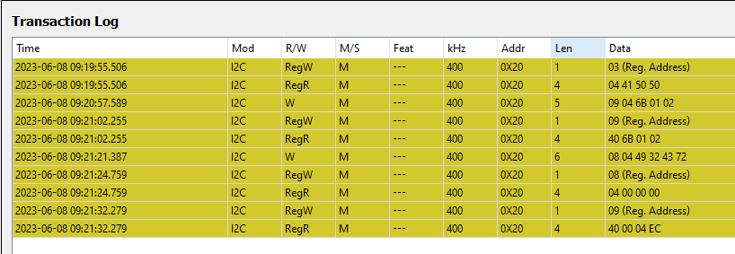
Full 4CC Transaction Log

Slide 3
Read register 0x03
04 41 50 50 -> APP

Slide 4
# of bytes
Slave Address
Register offset
# of bytes in register offset
Write to register 0x09 (DATA1)

Slide 5
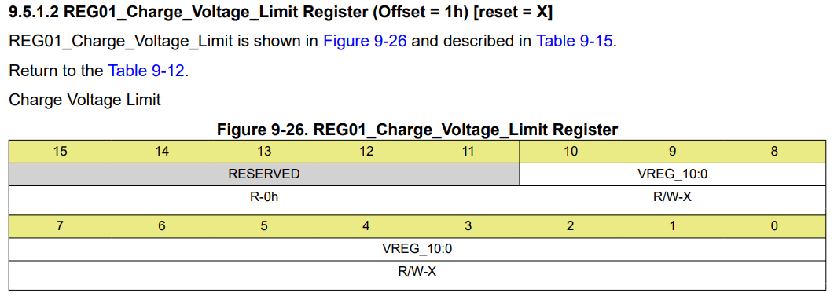
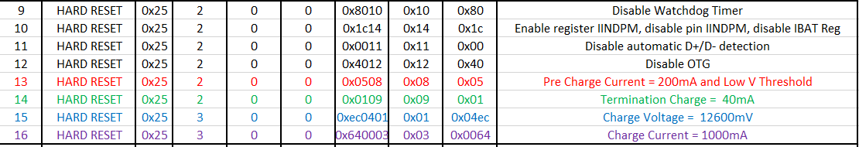
BQ Register
This I2Cr transaction was from 3S battery configuration, therefore return data 04ec will correlate to Charge Voltage 12600mV.
For Harman, return data should read: 03 48
Register
Data

Slide 6
Read register 0x09 (DATA1)
Ensure data matches that was written in previous step

Slide 7
4CC command
49 32 43 72 -> I2Cr
Write to register 0x08 (CMD1)
# of bytes

Slide 8
Read register 0x08 (CMD1)
Ensure 00’s -> Task Executed
# of bytes = 04 from 4CC
00’s

Slide 9
Read register 0x09 (DATA1)
Output return data from slave address: 6Bh
Register: 01h
# of bytes
04 EC read data from register 01h

